Slide 1






SECOND ML PROJECT
SIC AI
AUGUST 2024

Slide 2




PROBLEM
COMPANY HAS A HIGH ATTRITION RATE
Analyze dataset, understand the pattern of employee attrition
and predict future attritions
SIC AI
AUGUST 2024

Slide 3






DATA
PERSONAL INFORMATION
JOB PERFORMANCE AND SATISFACTION
JOB DETAILS
The data describes employees Personal Information like age, job details like
department, and job performance/satisfaction.
SIC AI
AUGUST 2024

Slide 4





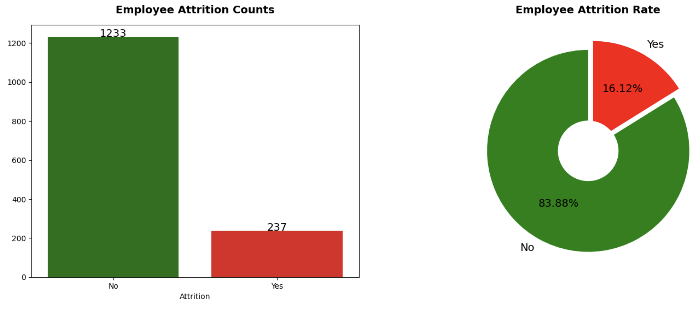

STEP 1: EDA
ATTRITION RATE IS 16%
SIC AI
AUGUST 2024

Slide 5
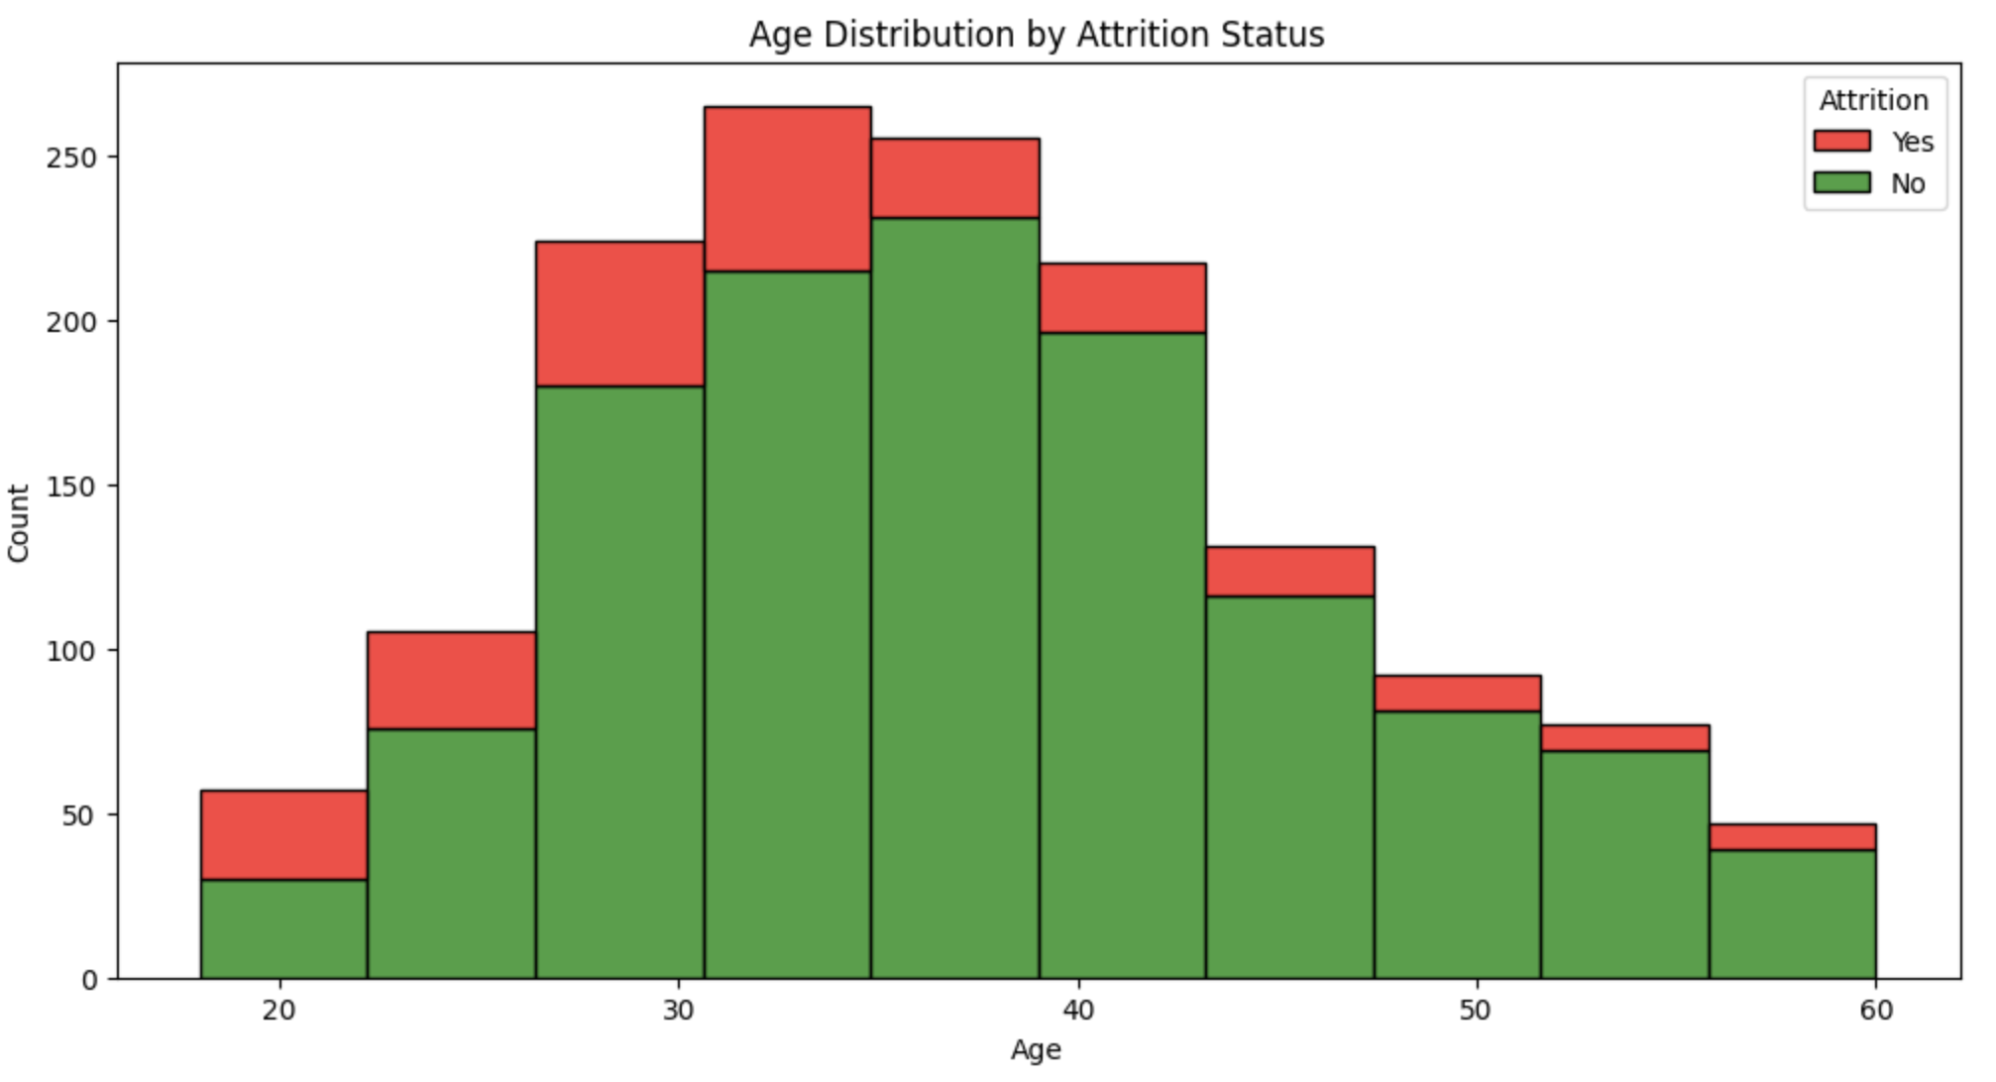

STEP 1: EDA+
Q1. How does Age affect Attrition?
AGE SEEMS TO MATTER AS MOST PEOPLE WHO ARE BETWEEN THE AGE OF 20-35 SEEM TO LEAVE MORE THAN OLDER COSTUMERS
SIC AI
AUGUST 2024

Slide 6


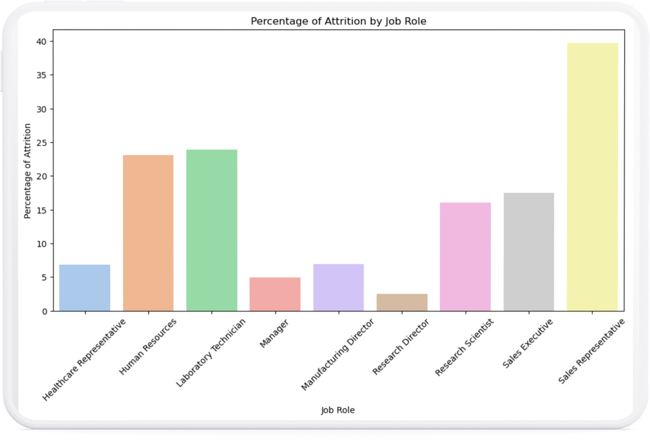


STEP 1: EDA+
What are the key factors contributing to employee attrition?
Sales seem to be leaving the most as 40% of them leave.
Also hr and laboratory techncian
Maybe because higher work pressure
SIC AI
AUGUST 2024

Slide 7


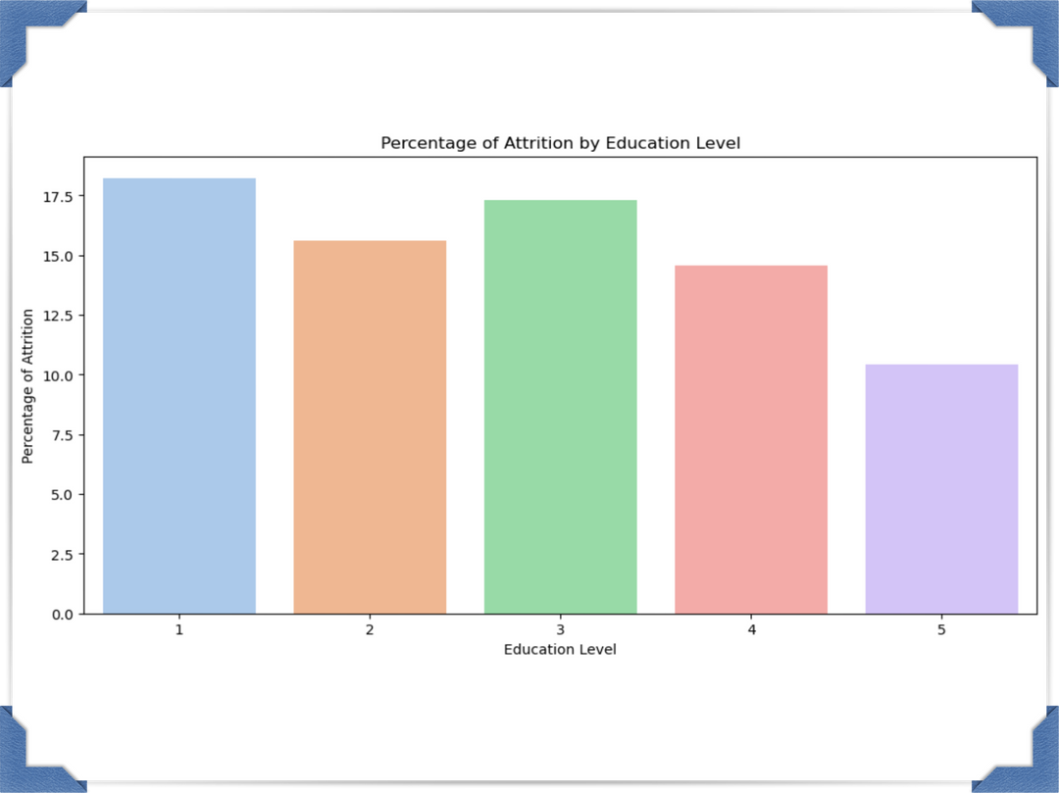

STEP 1: EDA+
HIGHER EDUCATED PEOPLE ARE MORE LIKELY TO GET JOBS THAT THEY CAN SPECALIZE IN AND BE SATISFIED WITH
What are the key factors contributing to employee attrition?
SIC AI
AUGUST 2024

Slide 8
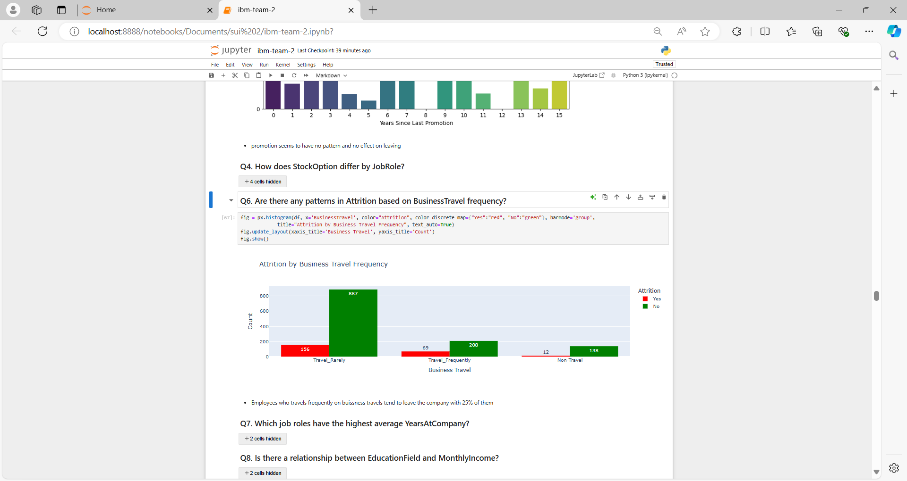
STEP 1: EDA+
Q6. Are there any patterns in Attrition based on BusinessTravel frequency?
People who travel frequently tend to leave more as 40% of them leave
SIC AI
AUGUST 2024

Slide 9





EDA +
Income average
Overtime percentage
People who are paid more stay more
People who work overtime stay less
What is the impact of OverTime and monthly income on employee performance

Slide 10

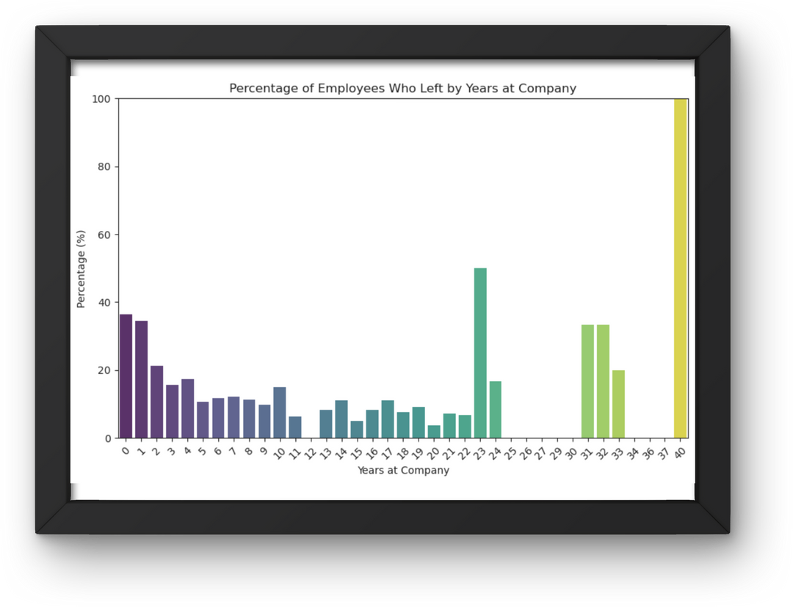


Eda++
How does years at company influence employee attrition?
01
The graph seems to have a prabola shape where people who stayed longest leave more and people who just started leave more
02
It seems that the company lacks the ability to hook new employees as 40% of them leave in the first two years

Slide 11
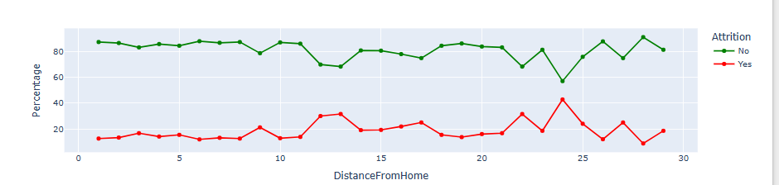
Eda++
How does DistanceFromHome influence employee attrition?
01
Distance from home seems to have a small but important effect on attrition
02
as distance from home increases, the percentage of attrition increases being at its atmost level when distance is larger than 10, espicially between 21-25 with 25% - distance from 5-10, the employees attrition percentage is 14.6% - 11-15, percentage is 21.7% - 16-20, percentage is 18.4%

Slide 12



1
Removed columns that were useless and feature engineering
3
Remove some highly correlated features and scaling
2
Label encoding, one hot encoding and mapping
PREPROCESSING
SIC AI
AUGUST 2024

Slide 13


MODELS
KNN
SVC
LOGISTIC RGR
NAYEV BAYES
SIC AI
AUGUST 2024

Slide 14

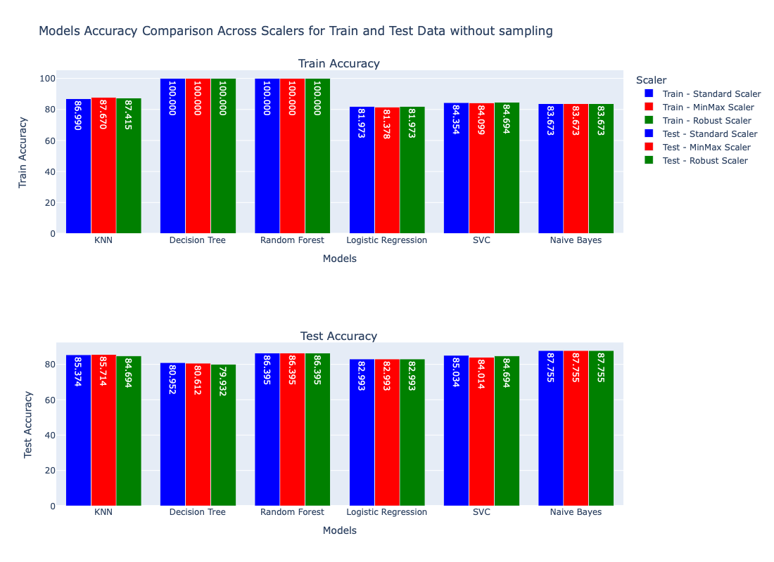

No Sampling
SICAI
August 2024

Slide 15
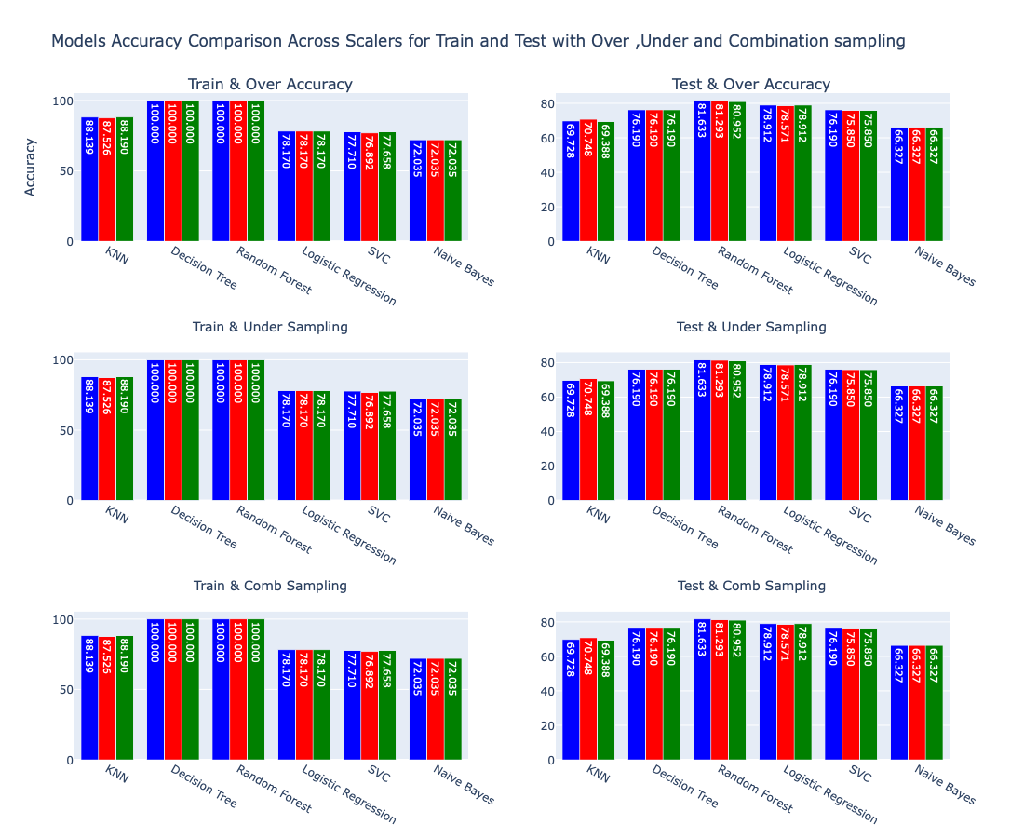
Different Sampling
SICAI
August 2024

Slide 16

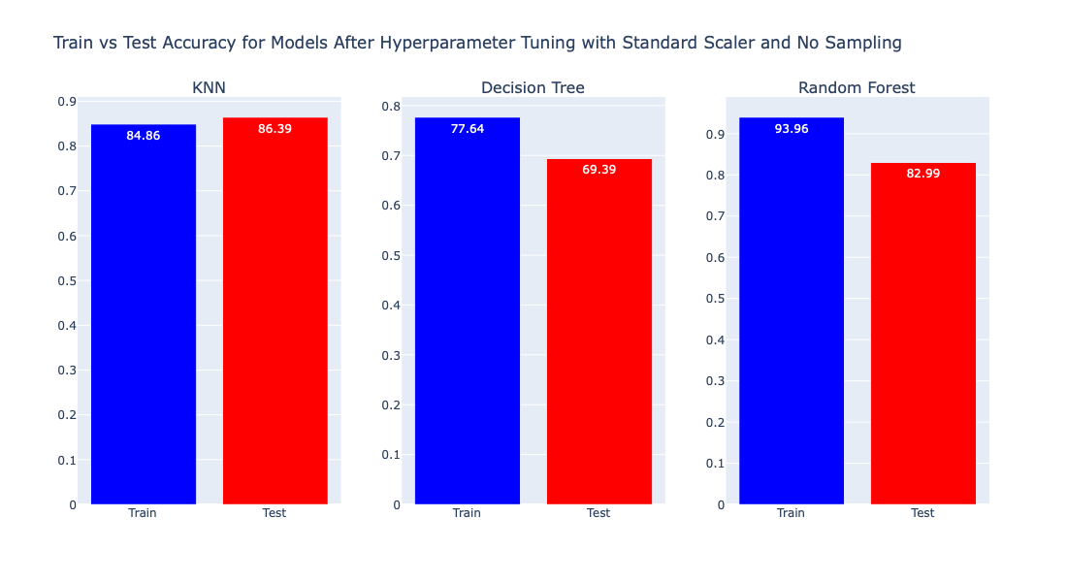
Hyperparameter Tuning
SIC AI
AUGUST 2024

Slide 17

THE END
SIC AI
AUGUST 2024

